Slide 1
Unit tests
SDEV 301

Slide 2

What is unit testing?
“Unit testing is a software development process in which the smallest testable parts of an application, called units, are individually and independently scrutinized for proper operation.”
Tests can be automated!
Part of Test Driven Development (TDD)
Write a failing test
Write the minimum amount of code necessary to pass the test

Slide 3
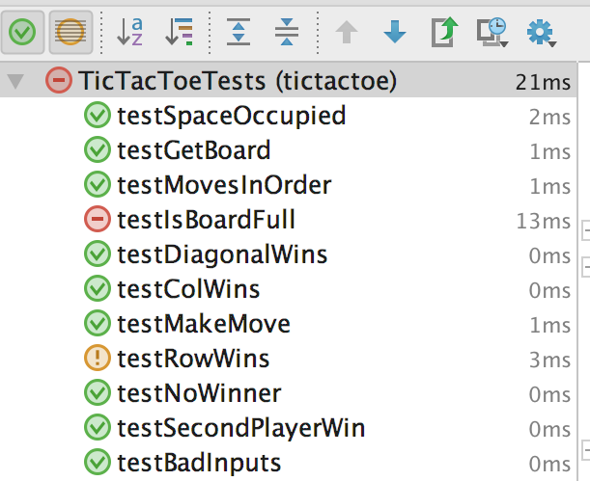

What is JUnit?
An open-source Java unit testing framework
It provides annotations and classes for writing JUnit tests
Most IDEs have a tool for running a group of Unit tests
What do we need to get started?
Source code
Testing framework
Test methods
IntelliJ JUnit Panel

Slide 4

What do we use from org.junit?
Import
org.junit.*
Annotations
@BeforeClass, @AfterClass
@Before, @After
@Test
@Ignore
Classes
Assert

Slide 5
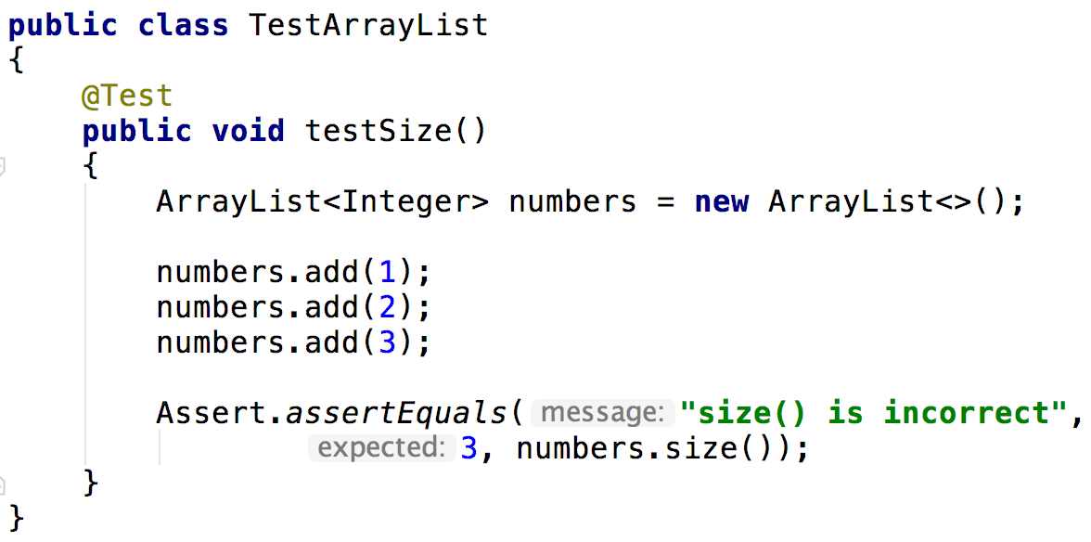
Writing a test – arrange, act, assert
Mark the test with an @Test annotation
Prepare a scenario
Verify behavior with the Assert class

Slide 6
Methods from the Assert class
Assert.* Method | Description
assertEquals(message, expected, actual) | Asserts that two values are equal.
assertNotEquals(message, unexpected, actual) | Asserts that two values are not equal.
assertTrue(message, actual) | Asserts that a value is true.
assertFalse(message, actual) | Asserts that a value is false.
assertArrayEquals(message, expected, actual) | Asserts that two arrays contain the same values.
fail() | Arbitrarily fails a test.

Slide 7
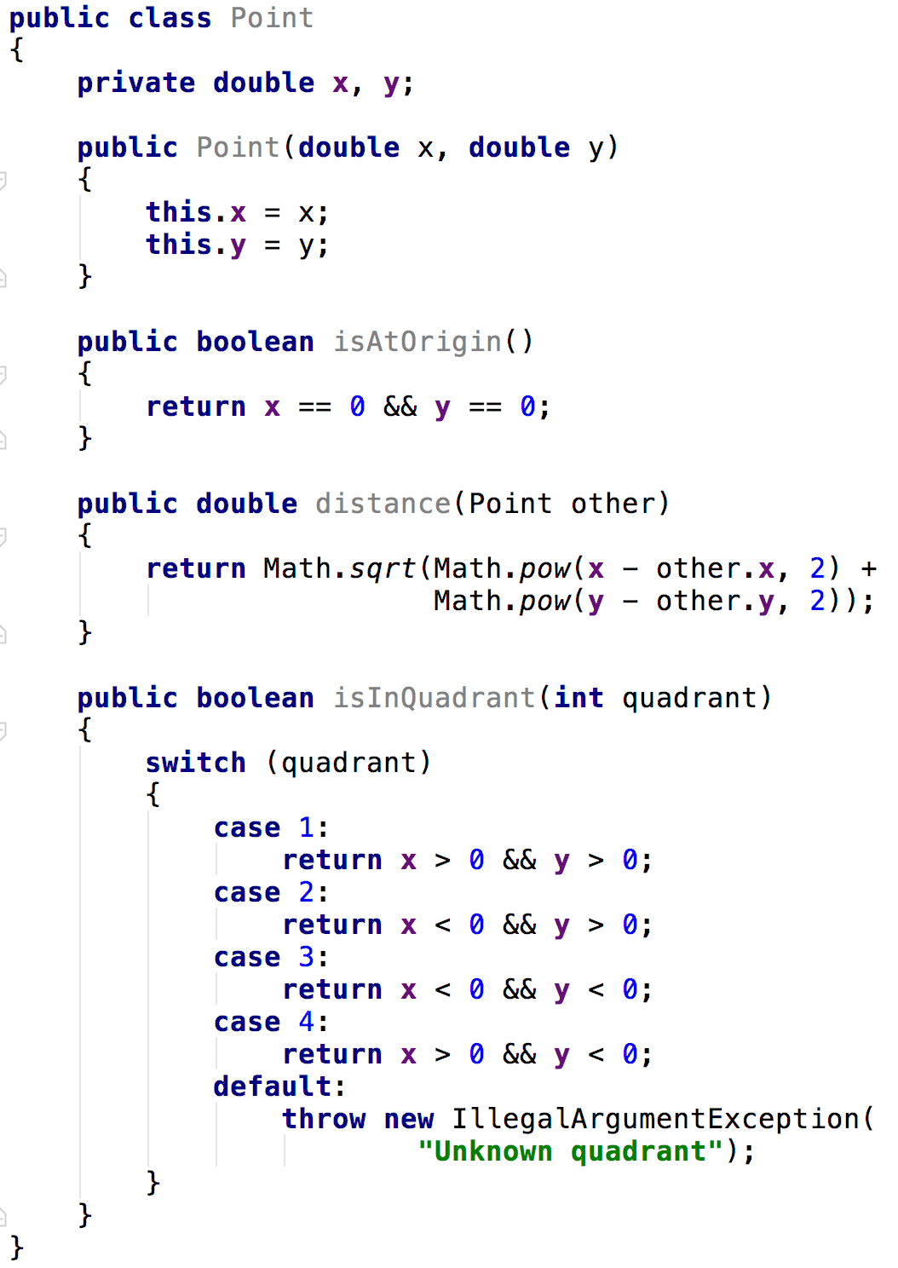
Testing a Point class
Focus on methods
You can have more than one test per method
Address inputs/outputs
You don’t have to test every possible input, but instead every type of input (equivalence classes)
Address exceptions
Try to identify edge cases
Does the origin lie in a quadrant?

Slide 8
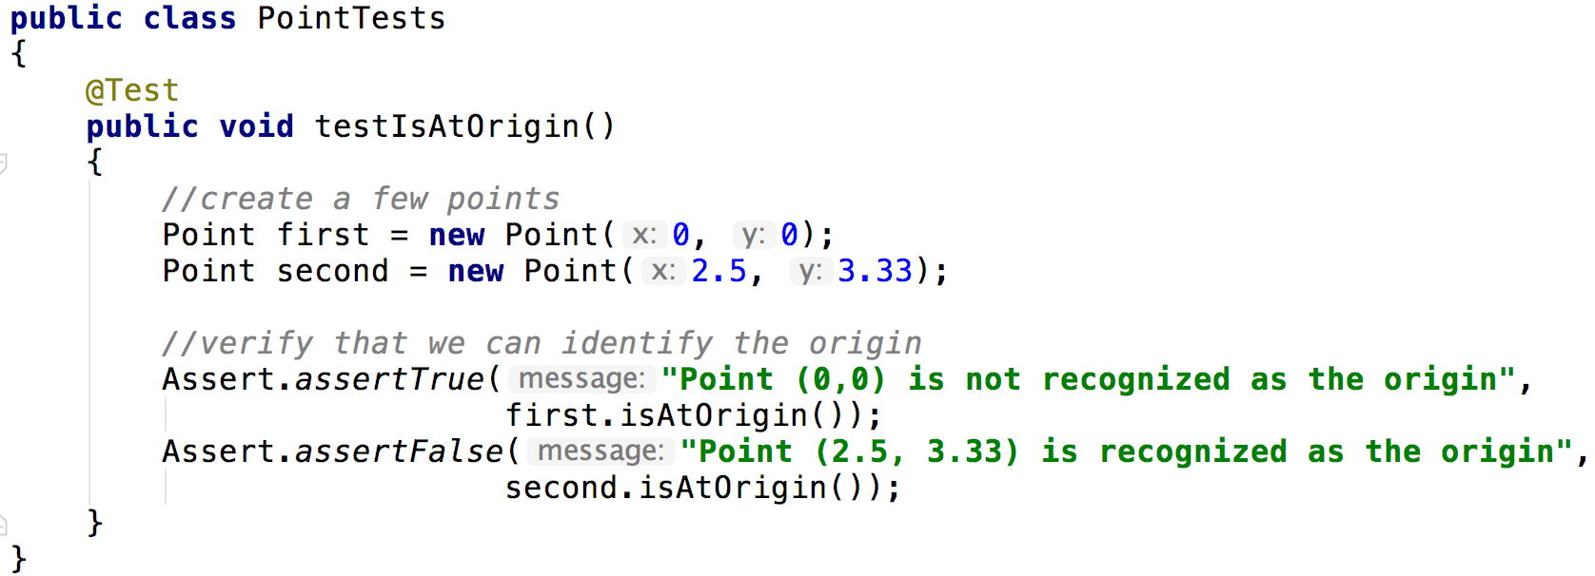
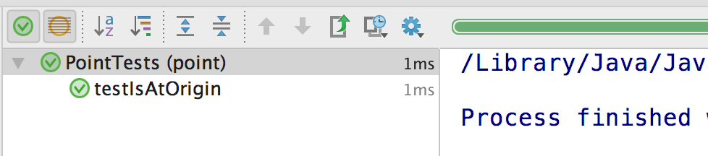
Testing isAtOrigin()
This message is displayed if isAtOrigin() is not true
Or false in this case
Our test has passed successfully

Slide 9
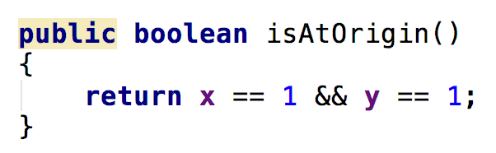
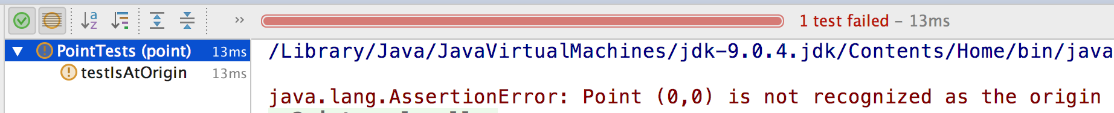
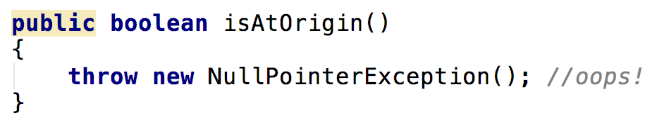
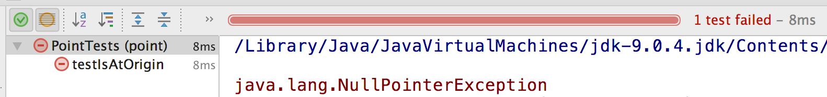
Other test outcomes
Fail: An Assert.* method is not able to verify a condition, throwing an AssertionException
Exception: An exception is thrown during test execution

Slide 10
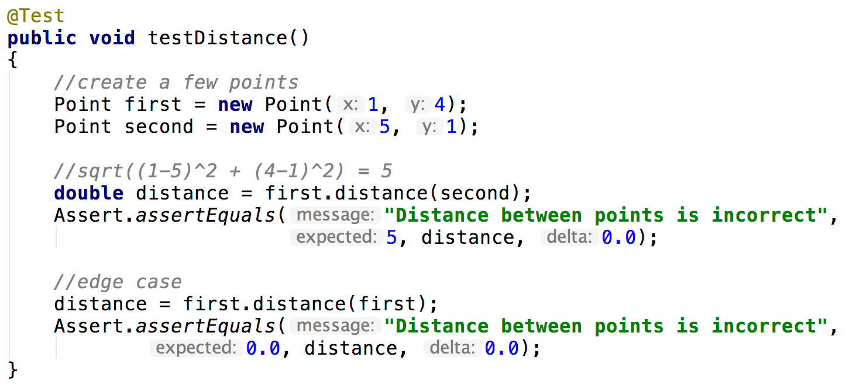
Testing distance()
assertEquals() with double inputs verifies that abs(expected – actual) <= delta

Slide 11
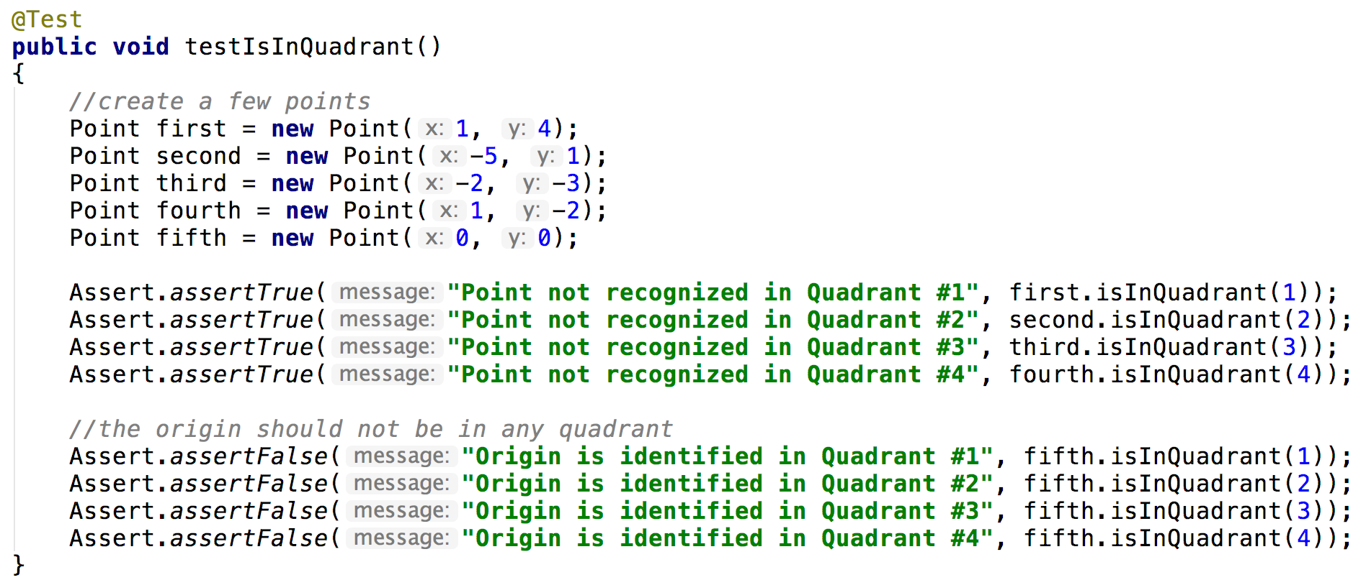
Testing isInQuadrant()
Does this test adequately check the behavior of isInQuadrant()?

Slide 12
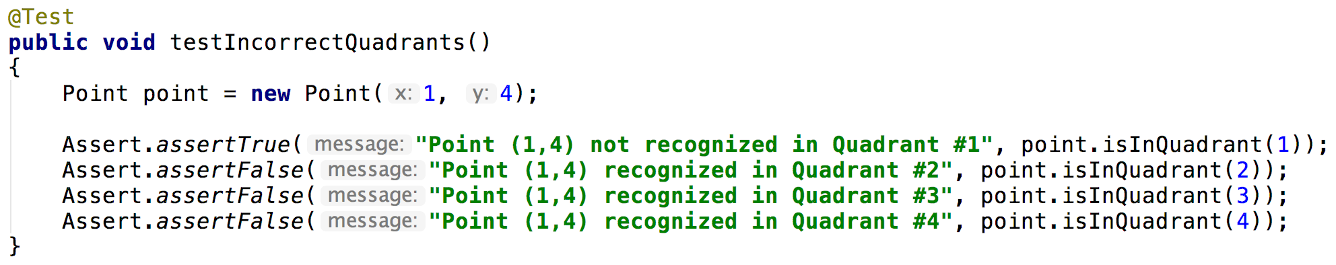
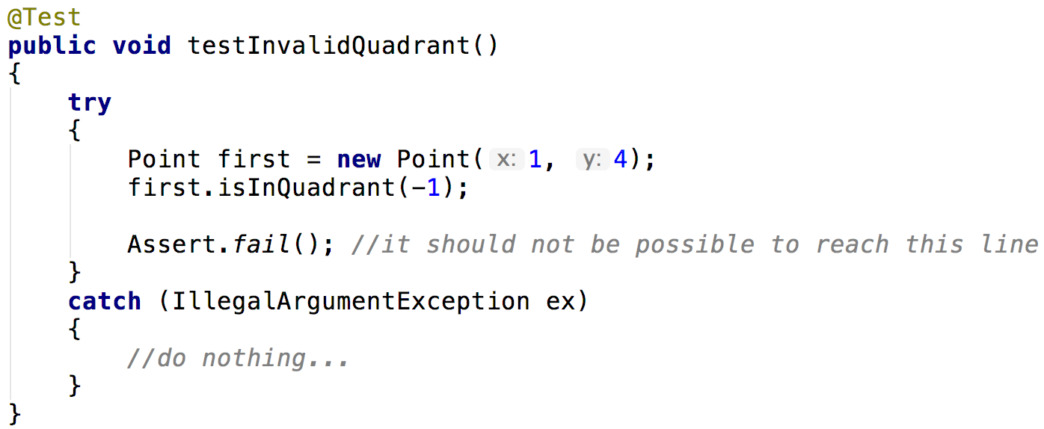
Testing isInQuadrant()
Verify that we don’t have false positives
Verify that our exception is being thrown

Slide 13
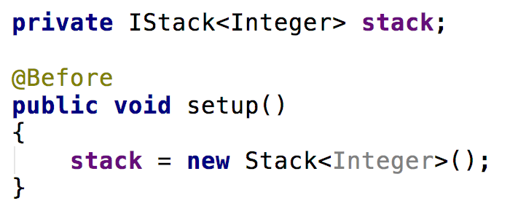
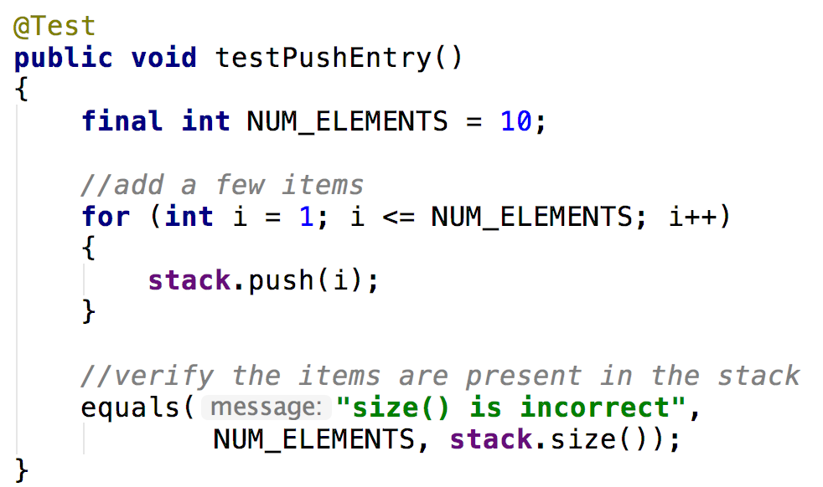
Preparing our tests with Text Fixtures
A fixed state of a set of objects used as a baseline for running tests.
The purpose of a test fixture is to ensure that there is a well known and fixed environment in which tests are run so that results are repeatable.
Examples of fixtures:
Preparation of input data and setup/creation of fake or mock objects
Loading a database with a specific, known set of data
Copying a specific known set of files

Slide 14
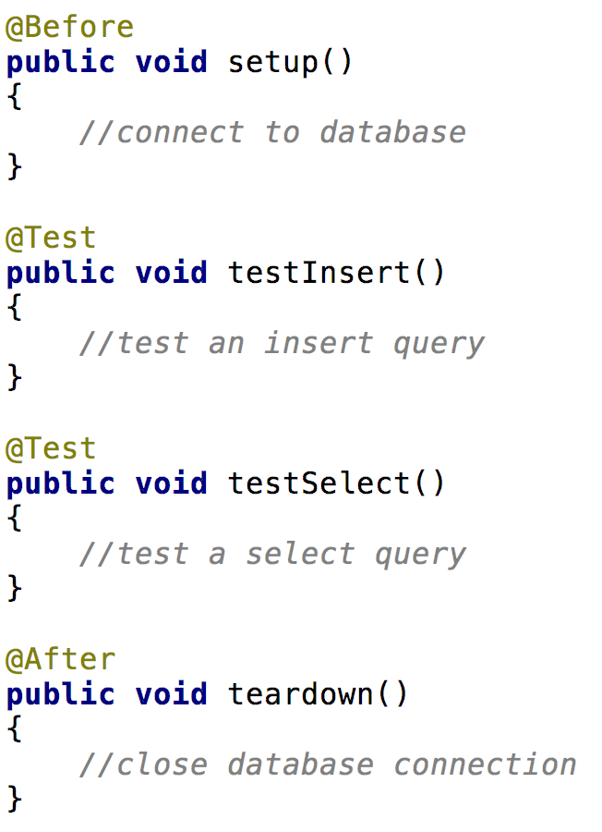
Setup and teardown
@Before: this method will execute before each test
@After: this method will execute after each test
Invocation Order
setup()
testInsert()
teardown() setup()
testSelect()
teardown()

Slide 15
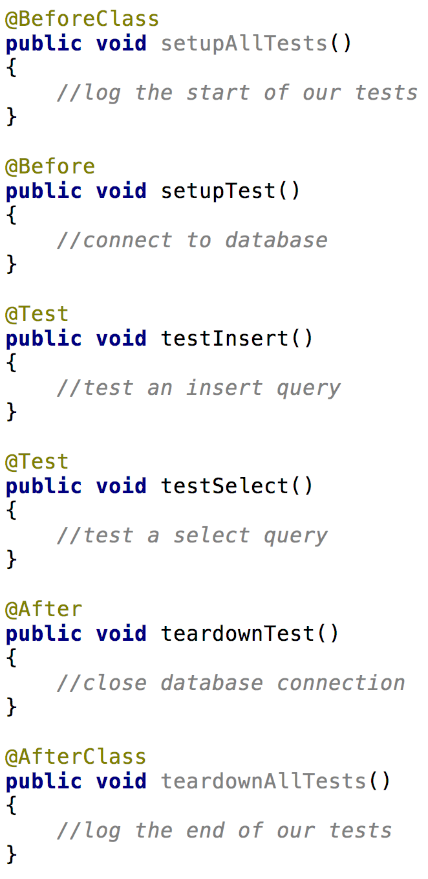
Setup and teardown
Order
setupAllTests()
setupTest()
testInsert()
teardownTest() setupTest()
testSelect()
teardownTest()
teardownAllTests()
@BeforeClass: this method will execute before any tests are ran
@AfterClass: this method will execute after all tests have ran

Slide 16
Sources
Rouse, Margaret. “What is unit testing? - Definition from WhatIs.Com.” SearchSoftwareQuality, 1 Jan. 2017, searchsoftwarequality.techtarget.com/definition/unit-testing.

Slide 17
Unit tests
SDEV 301

